Slide 1
Ethical Guidelines for Responsible Artificial Intelligence
Amir Mosavi (University of Public Service)
Anthony Theodore Chronopoulos (University of Texas San Antonio)

Slide 2
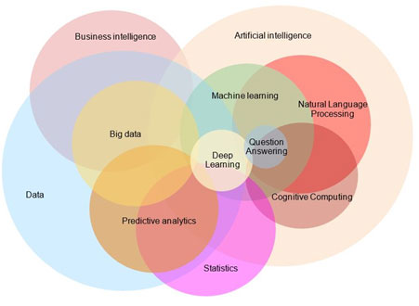
Machine Learning Progress
The True Dimension of AI
Due to AI effect the dimension of AI is unknown;
AI definition changes by time

Slide 3
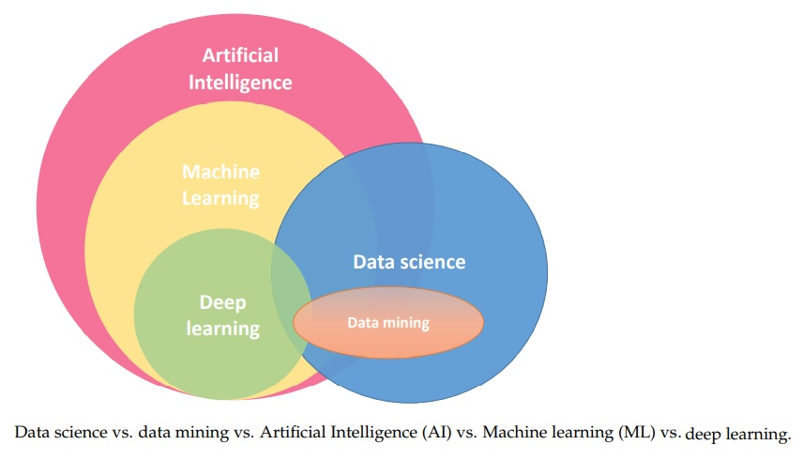
Machine Learning Progress
Taxonomies and Classifications of AI
Definitions change by time:
Contradicting sources in the literature
The content of AI research not measurable

Slide 4
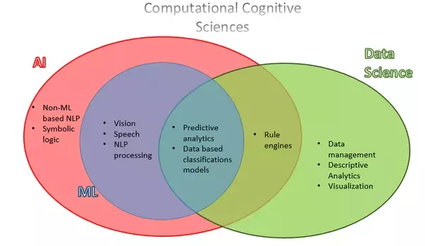
Machine Learning Progress
Taxonomies and Classifications of AI
AI and machine learning

Slide 5
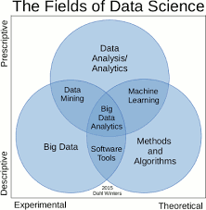
Machine Learning Progress
Taxonomies and Classifications of AI
AI, machine learning and the emerging data science

Slide 6
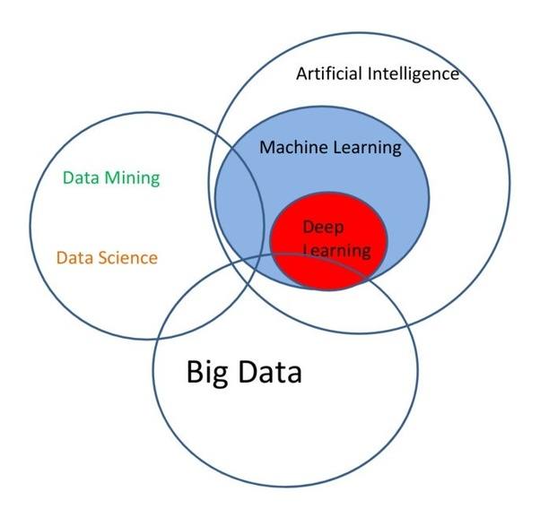
Machine Learning Progress
Taxonomies and Classifications of AI
AI, machine learning and the emerging data science

Slide 7
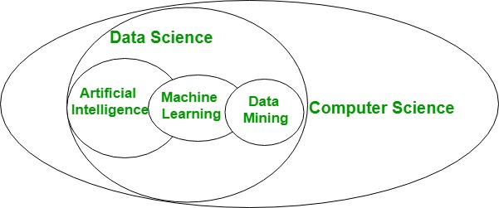
Machine Learning Progress
Taxonomies and Classifications of AI
AI, machine learning and the emerging data science

Slide 8
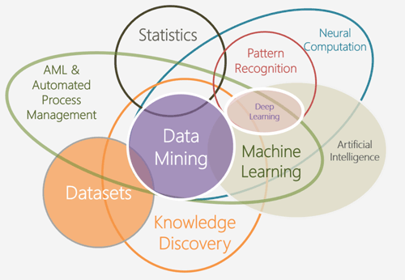
Machine Learning Progress
Taxonomies and Classifications of AI
AI, machine learning and the emerging data science

Slide 9
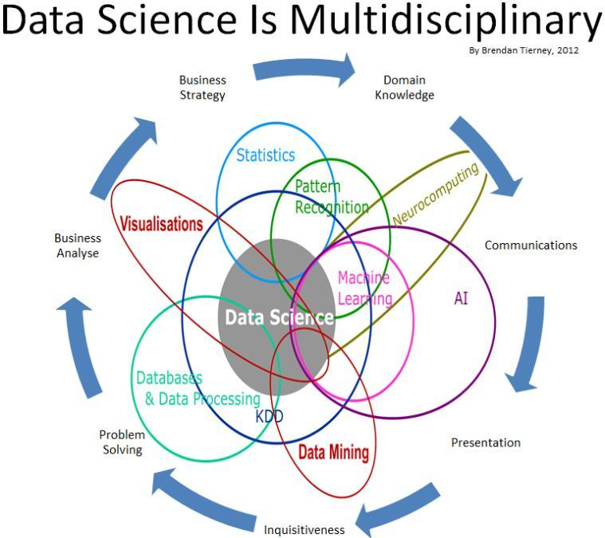
Machine Learning Progress
Taxonomies and Classifications of AI
AI, machine learning and the emerging data science in platform businesses

Slide 10
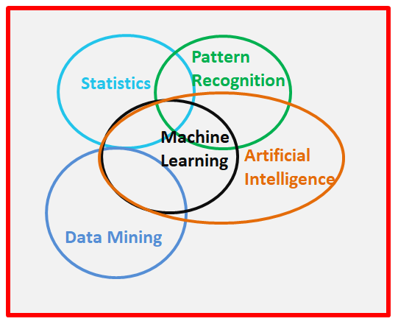
Machine Learning Progress
Taxonomies and Classifications of AI
The machine learning research is measurable
ML methods and applications have clear border and identification

Slide 11
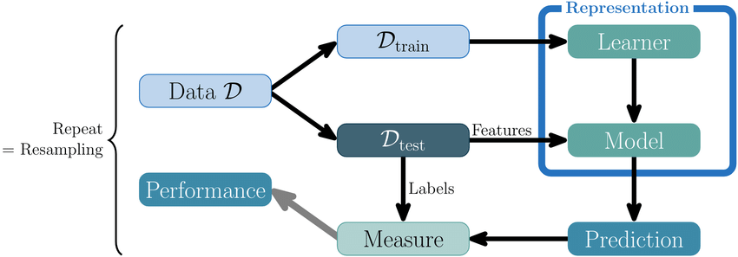
Modeling with Machine Learning
For responsible machine learning, data privacy, transparency, accountability, explainability, ethics, model quality, sustainability and various social aspects are yet to be integrated.
Research and development
(Universities)
Companies and end-users

Slide 12
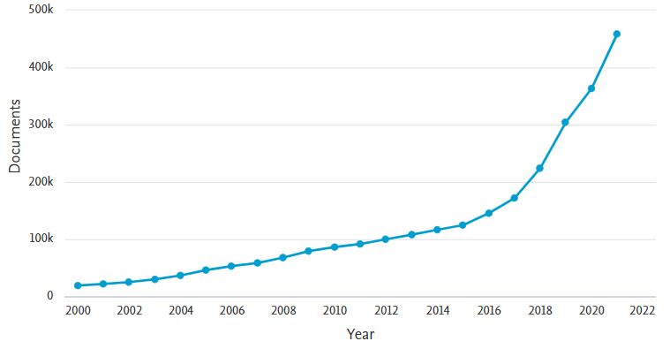
Machine Learning Progress
Machine learning progress
The machine learning research is measurable

Slide 13
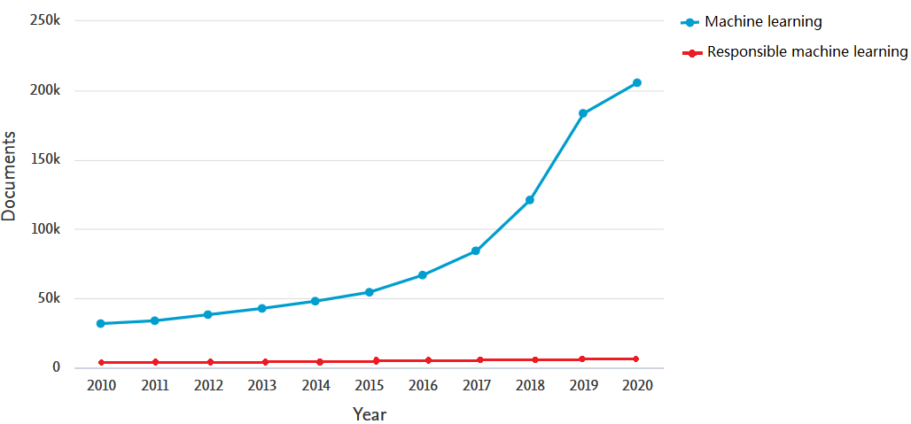
ML vs. responsible ML

Slide 14
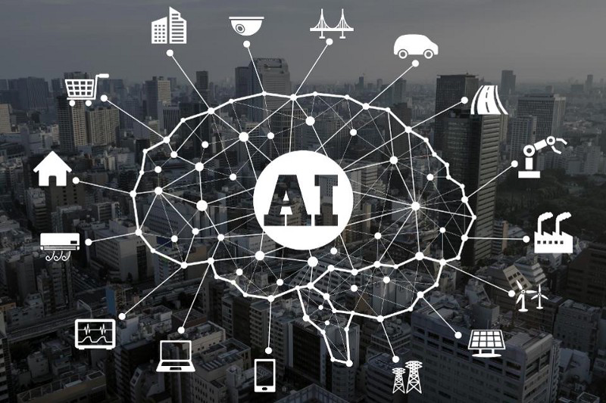
The platforms rely of ML
Importance of the ML in the Platform Economy

Slide 15
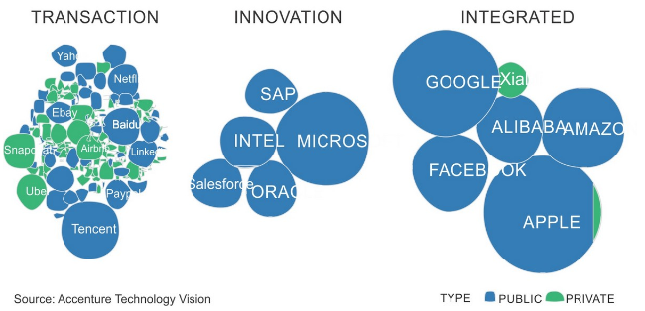
Dominance of the Platform Economy (ML is the core)
The platform businesses have taken the lead in almost all digital consumer markets.
Amazon and Alibaba in retail, Google in search and advertising, Facebook and Tencent in communication and external applications from the ecosystems, Netflix in media streaming and PayPal in payment.

Slide 16
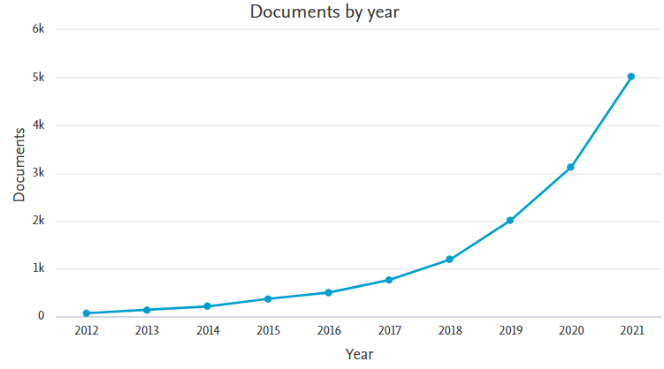
Machine Learning Progress
ML in platform economy
ML used by giants

Slide 17
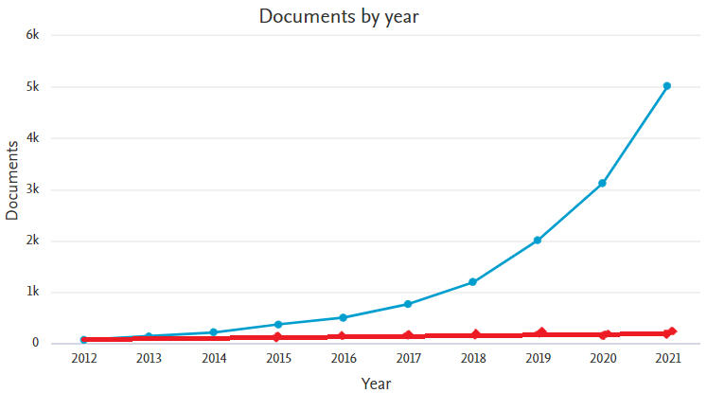
Machine Learning Progress
Responsible ML in platform economy
ML used by giants

Slide 18
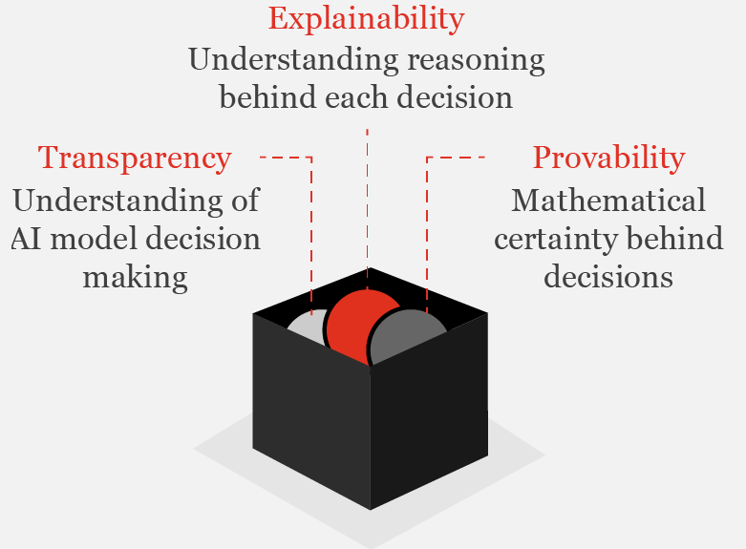
Research gap and the harmful consequences
Problem: lack of responsibility in black box
Social perspectives such as accountability, responsibility, and transparency; The outcome may be harmful, misleading, emotionally offensive, and damaging to the end-user, wider society, data privacy and a circular economy's ambition.

Slide 19
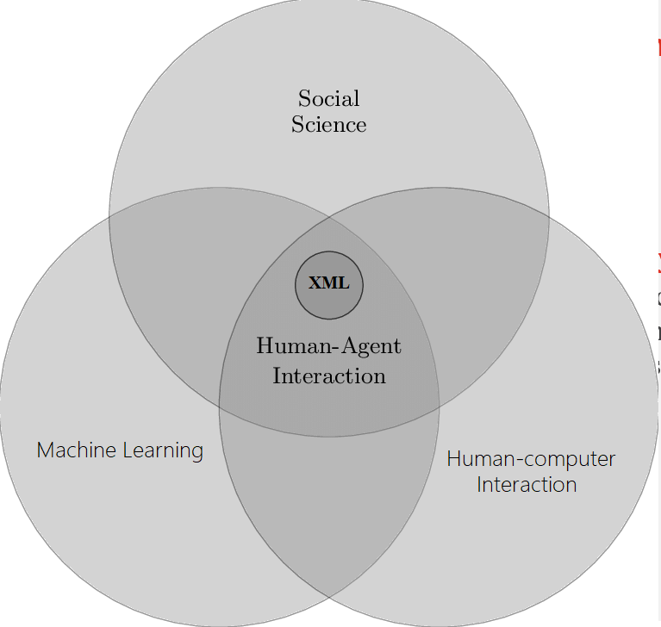
Aims of the Guidelines
Development and enforcing white box machine learning
Proposing essential guidelines in the individual scientific domains and disciplines including the platform economy

Slide 20
Guideline objectives
Developing ML models that are explainable, transparent and interpretable
2. Developing evaluation strategies
3. Developing and publishing guidelines
4. Developing responsible deep learning structures
5. Supporting the development of ML at the level of University and the Country

Slide 21
Ethical guidelines contributions
Leading the EU research for a “good AI society” to make the EU ICT industry worldwide competitive
Contributing to the societal challenges of Horizon2020, the EU Green Deal, and the European Flagship Initiative
Contributing to EU GDPR’s require transparency and accountability in AI outcomes, which will lead to dramatic changes in how ICT businesses operate, for supporting European Commission’s European AI Ecosystem.
New cross-field knowledge for both academy and industry
Publishing original unbiased data and algorithms, ensuring far reach for improving ethical principles

Slide 22
Thank you.

