Slide 1
DataExpert project planning system
A data driven way of thinking: in the perspective of transparancy

Slide 2
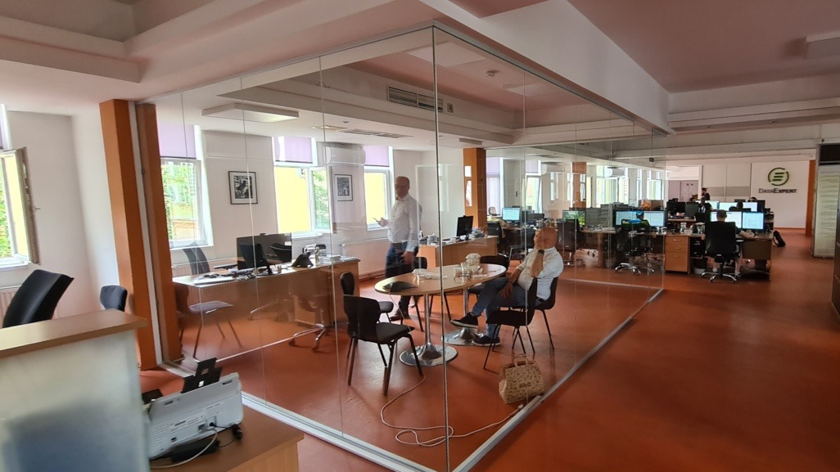

Slide 3
New employees getting a presentation training often have a very critical opinion about the system – while we have been asked for this session on the University of Public Service.

Slide 4
What we do

Slide 5
Our complete expertise
SURVEY
PROGRAMMING
SURVEY
HOSTING
DATA
PROCESSING
DATA
VISUALIZATION
BUSINESS INTELLIGENCE
CUSTOM DEVELOPMENT
ADVANCED DATA
ANALYTICS
MR TECHNOLOGY
TRANSITION

Slide 6
The business model of DataExpert
Fully based on human added value

Slide 7
Profitability
PROFITABILITY
TURNOVER SIDE
COST SIDE
salaries
taxes & related costs
material cost

Slide 8
What do I want to see
…as co-founder of the company?
If I am not satisfied with what I see, I want to get insight to why it is not OK and how to act proactively to get a better a result – or even better:
how to avoid issues and have just good result from the beginning
Real time turnover figures
Real time profitability figures

Slide 9
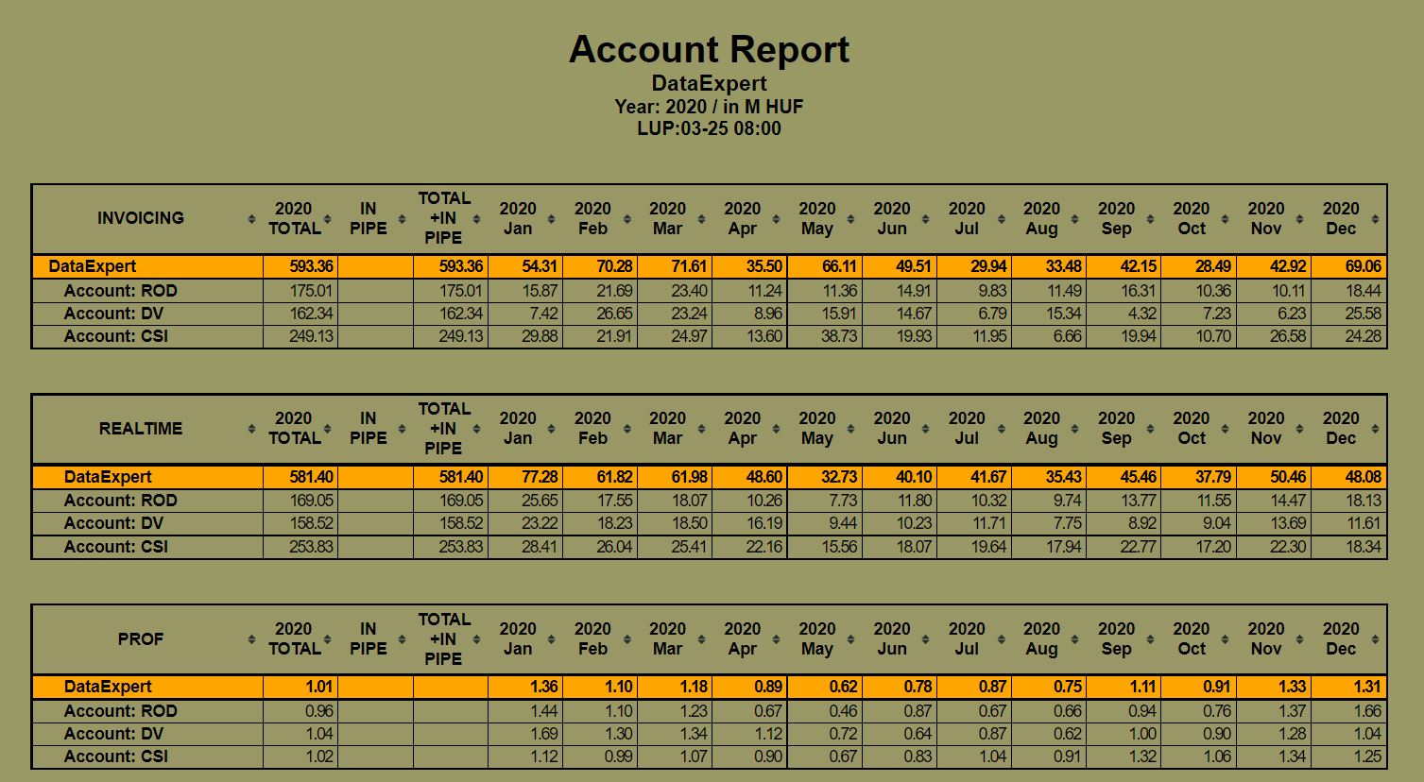

Slide 10
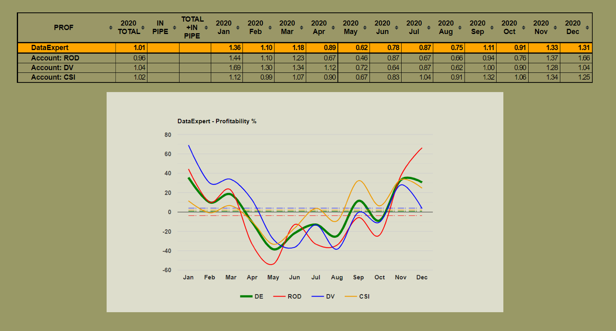

Slide 11
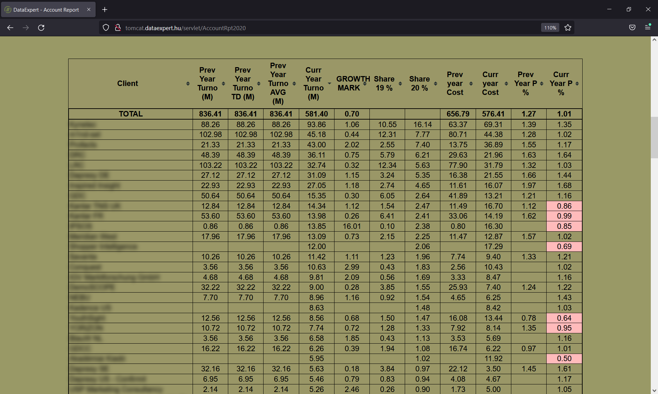

Slide 12
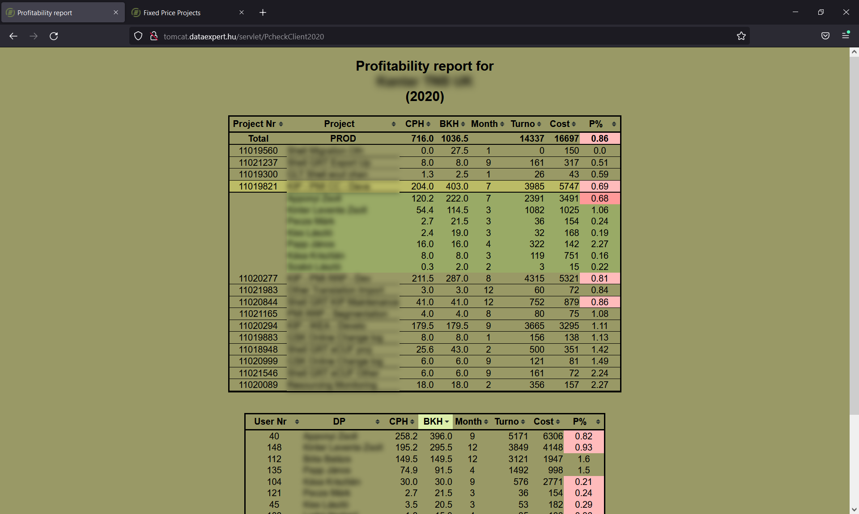

Slide 13
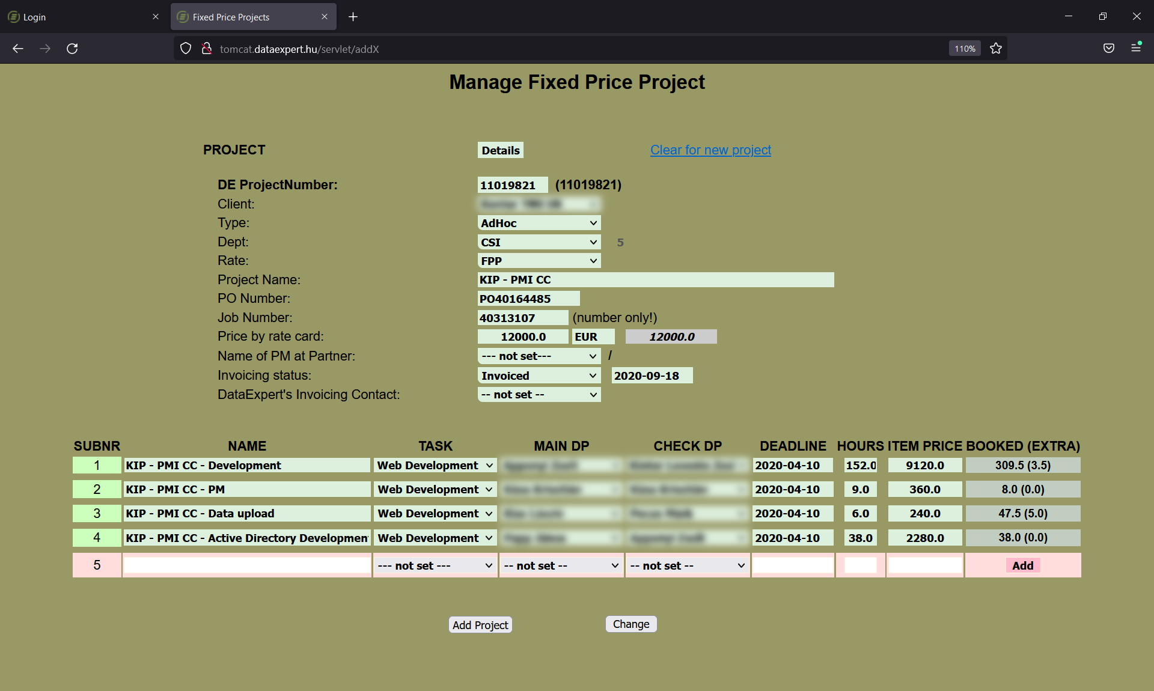

Slide 14
What’s behind this low profitability area?
„Almost double hours spent on this task”
Project effort estimation was too low
Execution efficiency was too low
Scope of task got wider during execution
Improve estimation accuracy / map potential traps, hard parts and build these into quotation standards to avoid these in the future and give more realistic quotations
Training, standardization, knowledge sharing, project management skills, communication
Discuss with client, negotiate to get them recognize effort and value of the work
ACTIONS TO BE TAKEN

Slide 15
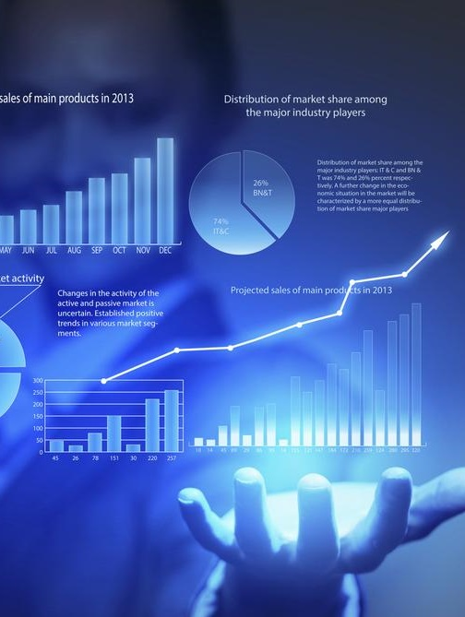
Using a business information system, we can:
Data driven leadership then means:
Continuous exploration
of the company’s own
activities and perfecting
operation by providing
value generating feedback
to employees, processes, standards and all of company life
Monitor points
of interests
Leaks in efficiency
Structure of income and efforts
Per client, per task, per department, per colleague

Slide 16
Information transparency
All colleagues have access to data regarding
Their projects’ planned and spent hours, peer contribution on the project and financial value of it
The occupation figures of the members of their own team – to facilitate work distribution.
The most important measures of their performance and by which different aspects of their operation are evaluated.
Per client turnover figures (current and historical) empowering them to make commercial decisions themselves.
per client turnover figures (current and historical) empowering them to make commercial decisions themselves.

Slide 17
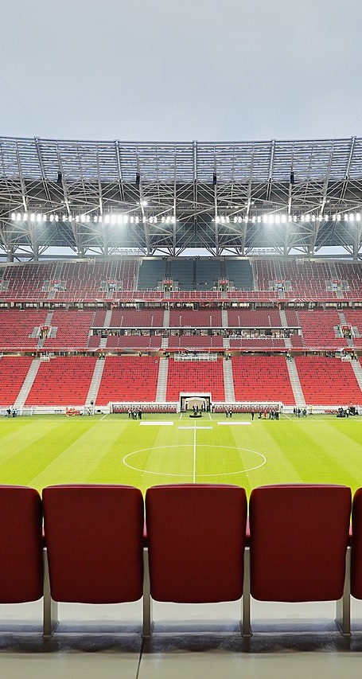
Transparency: further highly important effects.
Continuous focus on commercial performance.
Making possible for colleagues to take action at their desk in their scope of operation when presented indicators call for it.
Reinforces of the economic consequences of actions and attitudes.
Provides a common framework/context so “We are watching the same match”.
Alignment to company goals and values.

Slide 18
High level considerations for information systems
“In God we trust. All others must bring data.”
Everything is data but data is not everything.
Data and metrics may connect you to reality.
Data and metrics may cut you off from reality.
Life is bigger than human mind (and systems) can (ever) accommodate.
Only integrous usage of data will contribute to positive changes. (devotion to truth, equanimity, authentic curiosity, expertise, awareness of limitations)

Slide 19
Marketing & Innovation & Sales
Want to learn more? Visit www.dataexpert.hu

Slide 20
THANK YOU

